Slide 1
Bioinformatic Analysis for Cancer Genomics
Course overview
15/12/2024
Phuc Loi Luu, PhD
Email: Luu.p.loi@googlemail.com
Zalo: 0901802182

Slide 2
Content
The Teams help US!
What we will learn from the course?
What you can do after the course?
Housekeeping: Github and youtube

Slide 3
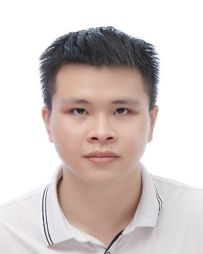

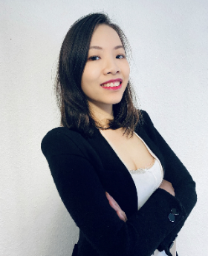
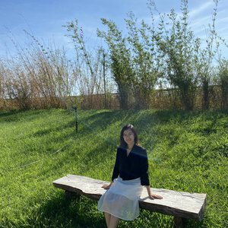

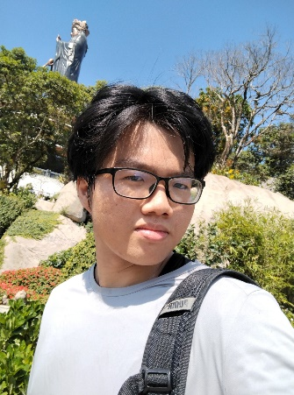


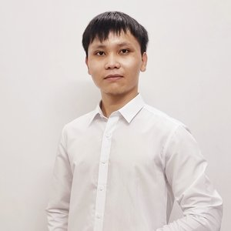
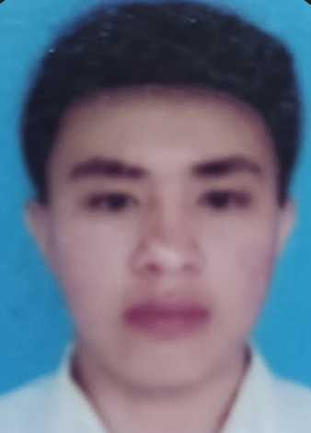

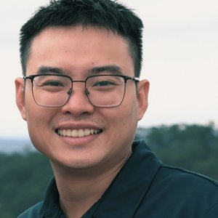


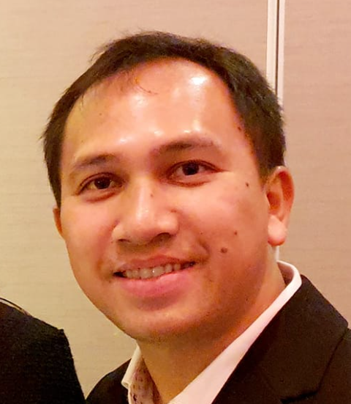
TEACHING ASSISTANT TEAM (TRỢ GIẢNG)
Nguyễn Quang Khải
nguyenkhai12330@gmail.com
Hà Gia Huy
hagiahuy311@gmail.com
Hồ Phú Quý
hophuquy0944@gmail.com
BS. Hoàng Sơn
hoangsonltt710@gmail.com
BS. Minh Nguyễn
ducminhnguyenle30091996@gmail.com
ThS. Nguyễn Quỳnh Như
Lucianhu@gmail.com
ThS. Trần Thị Mỹ Qui
ttmqui1912@gmail.com
Duy Đào
khuongduying@gmail.com
ThS. Ngô Đại Phú
phudaingobio@gmail.com
Nguyễn Mạnh Hùng
hungtrangan141@gmail.com
Lê Văn Giàu
lgiau6366@gmail.com
Phạm Văn Quan
quanpham0512@gmail.com
Hoàng Kim
vanhohoangkim@gmail.com
ThS. BS. Đào Ngọc Bắc
daongocbac2020@gmail.com
TS. Trịnh Vạn Ngữ
VNTrinh@mdanderson.org

Slide 4


LOGISTIC TEAM (HẬU CẦN)
Hoàng Kim
vanhohoangkim@gmail.com
Nguyễn Lê Quang
quanglequang2003@gmail.com
Lê Giàu
lgiau6366@gmail.com

Slide 5
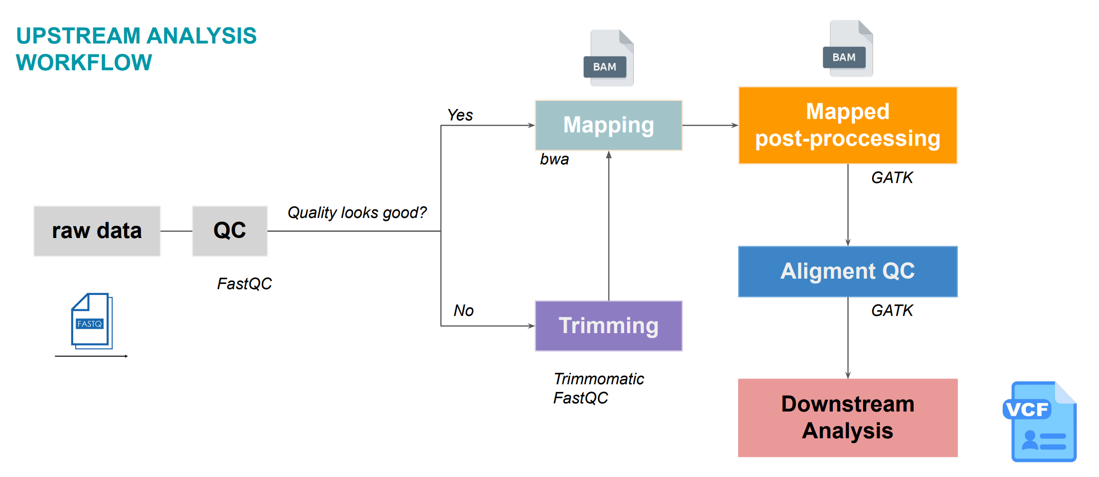
Adopted from Duy’s slide

Slide 6
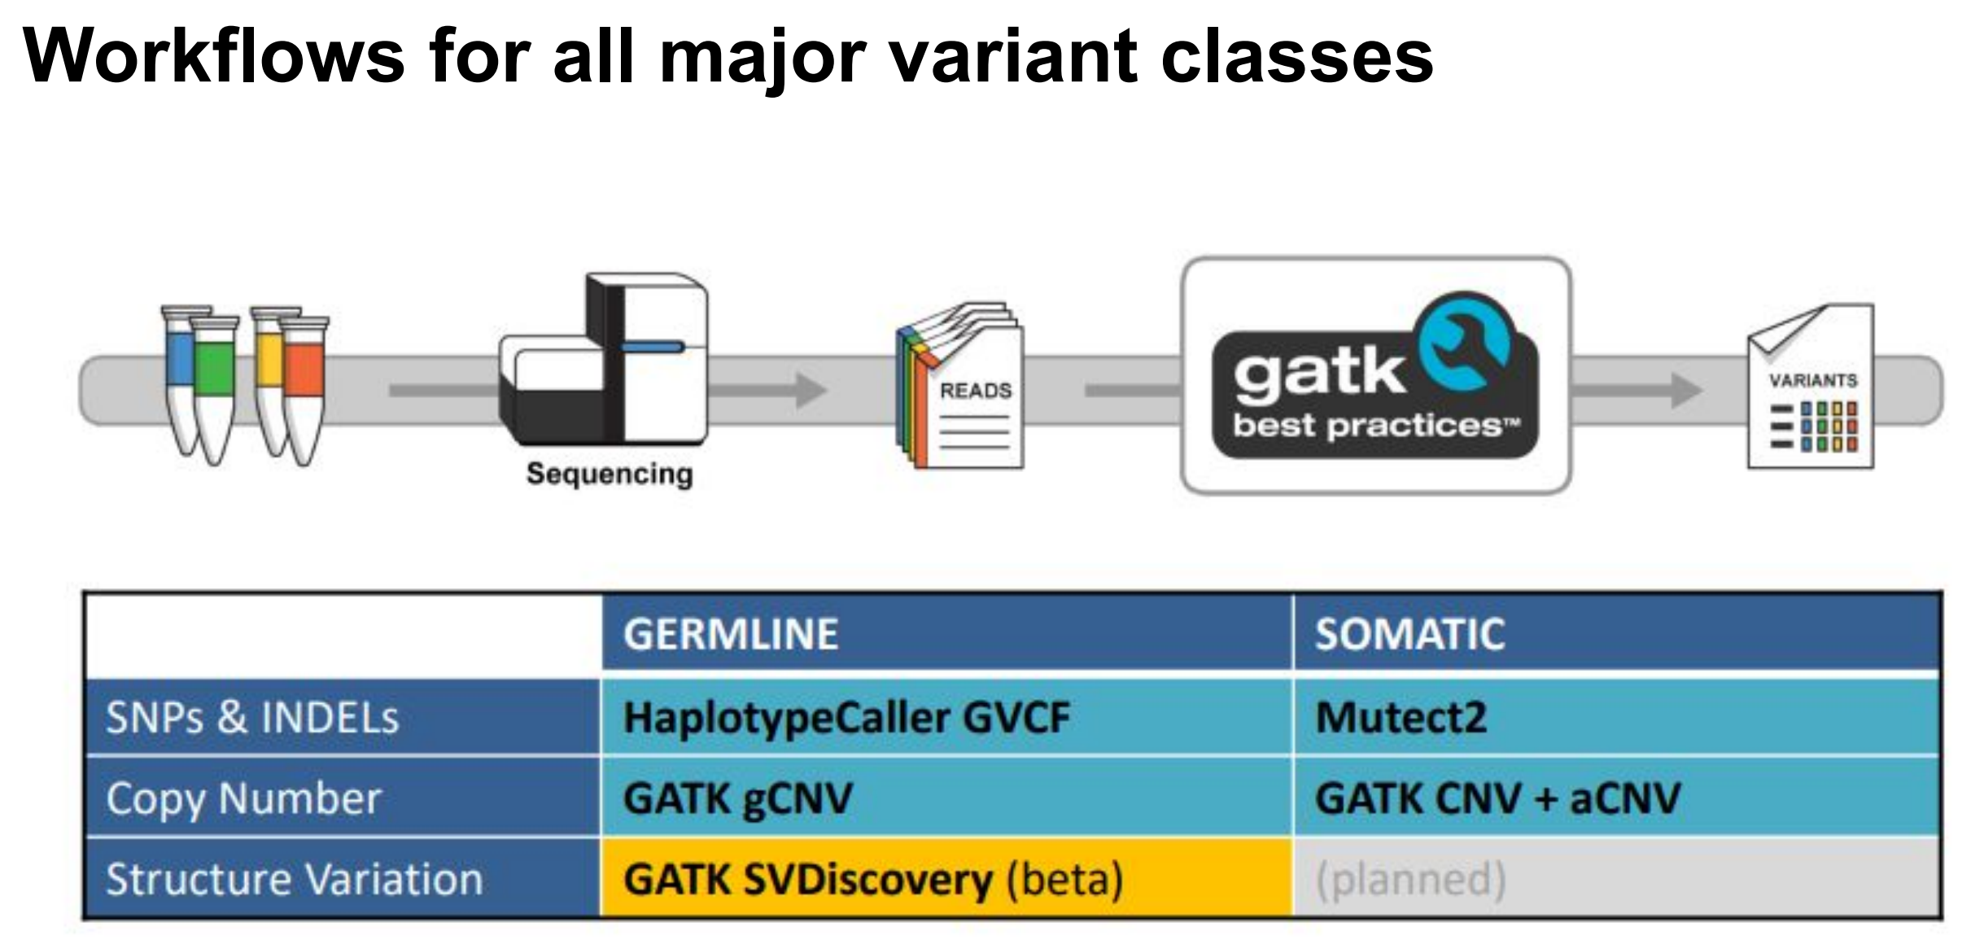
Adopted from Minh’s slide

Slide 7
Methods
No | Sequencing Platforms | Read mapping | Single Nucleotide Variant (SNV) Calling | Structural Variant (SV) and Copy Number Variant (CNV) Calling | Variant Annotation
1 | Illumina | BWA-mem, Bowtie2, SOAP2, Minimap2, BLASR, NGMLR … | SAMtools, Deepvariant, GATK, SpeedSeq … | DELLY, BreakDancer, LUMPY, GRIDSS, TARDIS, SURVIVOR, PBHoney, NanoSV, Manta, CNVnator … | HPO, ClinVar, Varsome, Gnomad, Cosmic, ANNOVAR …
2 | Onso (Short read, PacBio) Revio (Long read, PacBio) |  | Mummer | AMOS assembly, assembler ALLORA, minimus2 and BLASTR
3 | Ion Torrent PGM | Bowtie2 | SAMtools | Velvet and Newbler
4 | MGI Cyclone-SEQ (Long read) |  | Mauve | Newbler
5 | GeneMind | SMALT | SSAHA
6 | Aviti (Element Biosciences) | BWA |  | Ray Meta
7 | ONT (Long read)
10.1186/s12864-024-10239-9 and 10.1186/s13059-019-1828-7

Slide 8
What we will learn from the course?
Install and use Ubuntu or Google Colab
Hands-on programming with Bash and R, Linux command lines, and some bioinformatic tools
Manipulate Next Generation Sequencing data of DNA in both research and clinical application
Plot DNA-seq data with ggplots and do statistically analyzing with R
Downstream analysis of DNA-seq
Read publications of DNA-seq research
Discuss the DNA-seq testing reports
Search for driver and passenger mutations in cancers

Slide 9
What you can do after the course?
Use Ubuntu or Google Colab
Master programming language (Bash and R), Linux command line, and some bioinformatic tools
Manipulate Next Generation Sequencing data of DNA for both research and clinical application
Plot ready-for-publication figures and do statistically analyzing for a manuscript
Downstream analysis of DNA-seq
Understanding publications of DNA-seq
Understanding genetic counseling
Predict genomics cancer biomarkers and drug targets

Slide 10
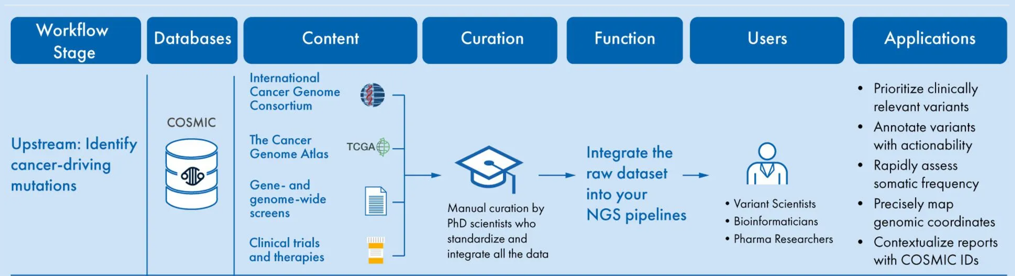
COSMIC for clinical NGS testing
https://digitalinsights.qiagen.com/somatic-mutation-databases-for-clinical/

Slide 11
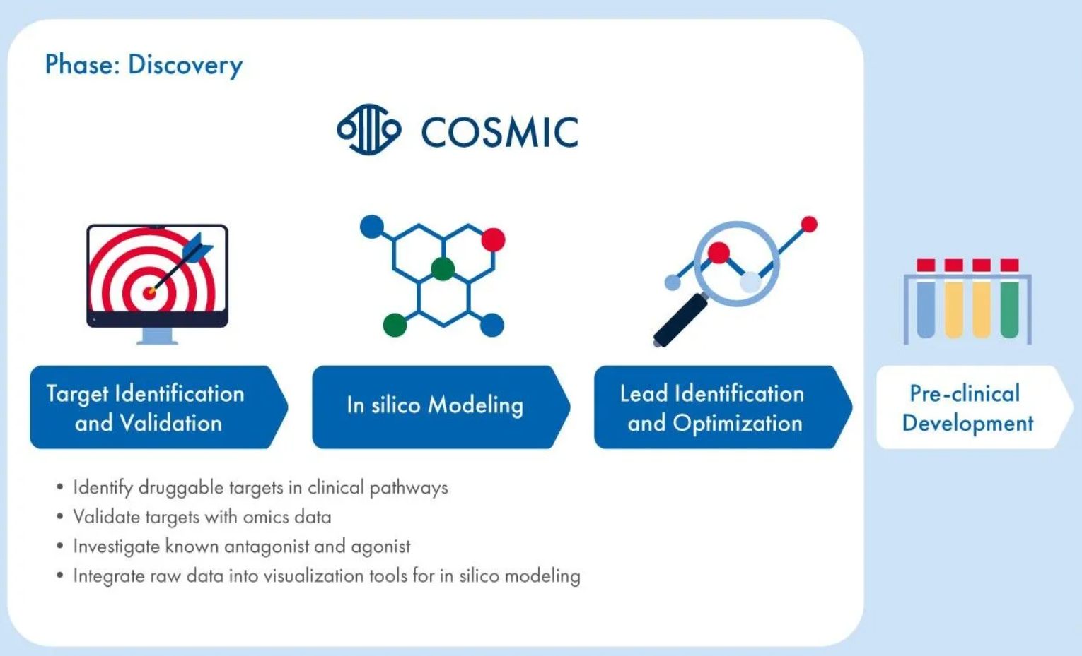
COSMIC in the cancer drug discovery
https://digitalinsights.qiagen.com/cosmic-hsmd-biopharma/

Slide 12
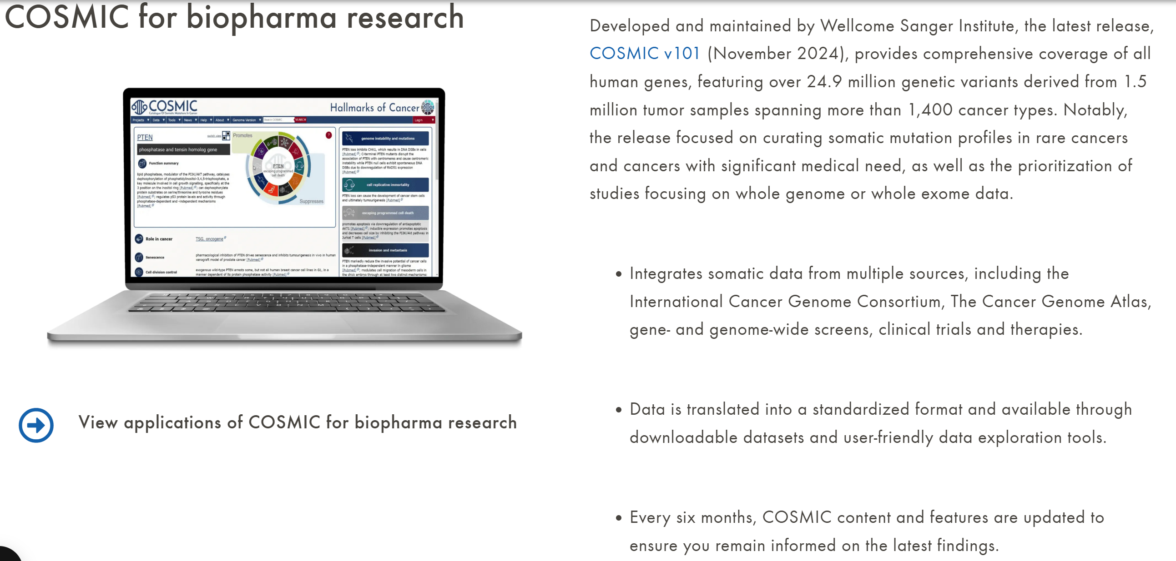
COSMIC for biopharma research

Slide 13
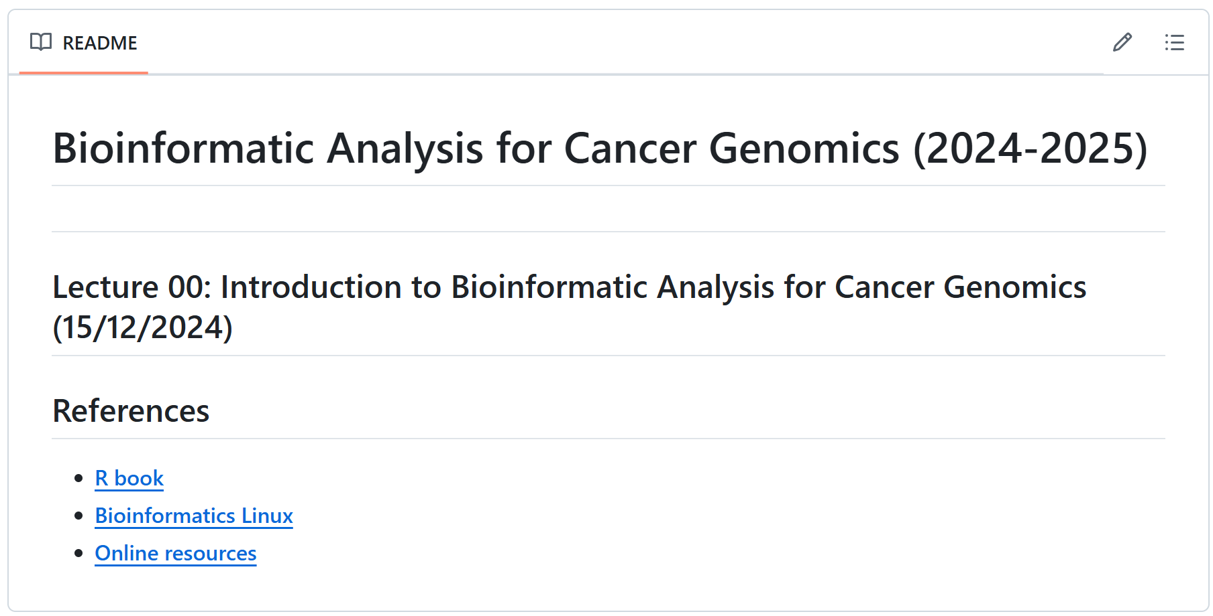
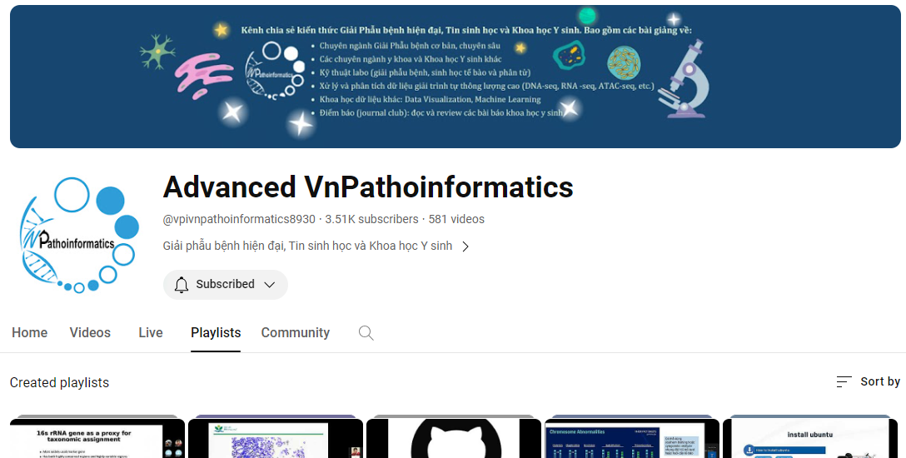
Github and youtube
Github: Lecture Slides, Codes/scripts, Exercises, Books and Q&A
https://github.com/luuloi/Bioinformatic_Analysis_for_Cancer_Genomics
2. Youtube:
https://www.youtube.com/@vpivnpathoinformatics8930/playlists

Slide 14
Thank you for your listening!
Phuc Loi Luu, PhD
Email: Luu.p.loi@googlemail.com
Zalo: 0901802182

